Slide 1
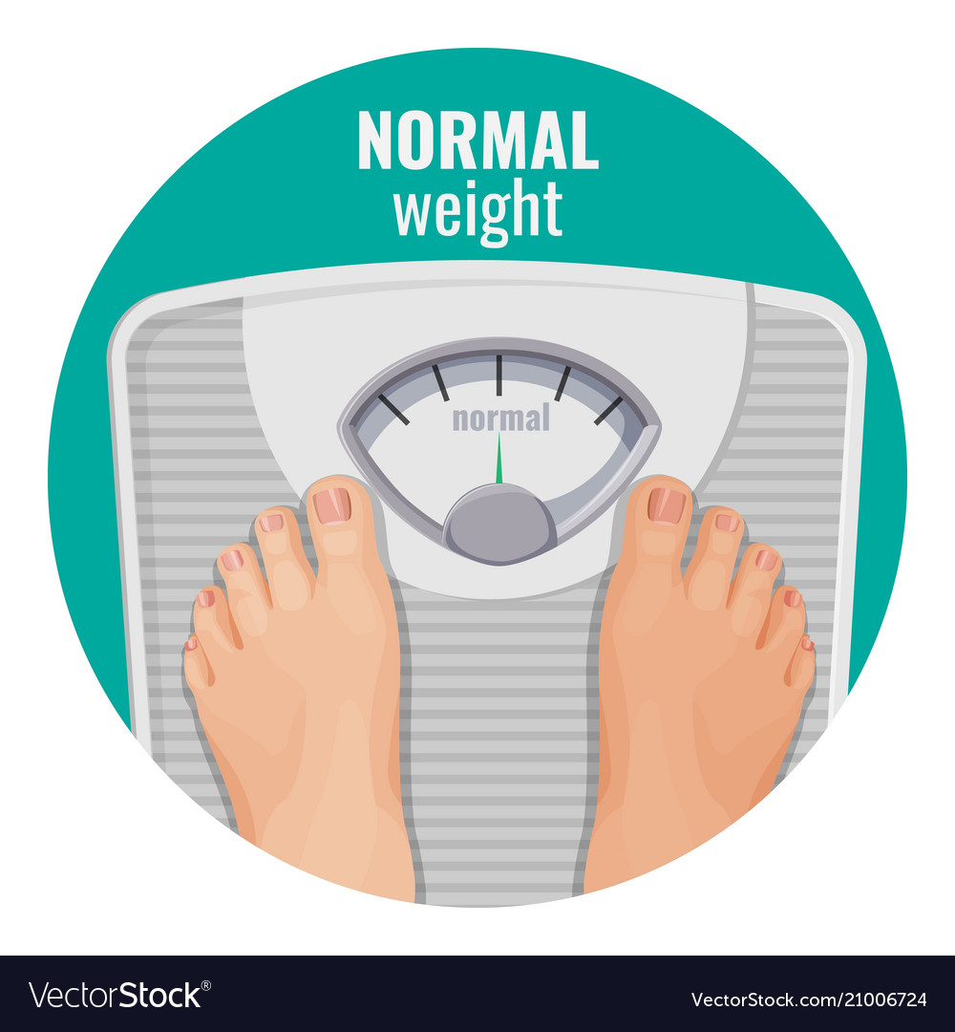
Normal weight
Why you should build muscles and start working to build the strength power
Muscle increases metabolic rate
Muscle fortifies the bones, ligaments and tendons
Muscle makes everyday activities easier
Muscle gives you shape
Decreased disease risks
How to build muscle safely
Increase Your Training Volume
Focus on the Eccentric Phase
Decrease Between-Set Rest Intervals
To Grow Muscle, Eat More Protein
Focus on Calorie Surpluses, Not Deficits
Snack on Casein Before Bed
Get More Sleep

Slide 2
This things should be included in your diet and remember during your strength and muscle building your diet matters the most
Homemade protein smoothies (There are many delicious protein smoothie recipes. Avoid most commercial versions, which may contain added sugar and aren’t as nutritious)
Milk (Drinking milk is a great way to add protein to your diet. It contains both casein and whey proteins)
Rice (Rice is a great source of carbs that are easy to consume and digest)
Nuts and nut butters (Nuts and nut butters are delicious, high calorie treats. They’re great for you and easy to add to many different snacks or recipes)
Red meats (Red meat is an excellent source of protein that will help you gain muscle. It contains leucine, an amino acid that helps stimulate muscle protein synthesis. The fattier the meat, the more calories you’ll take in)
Potatoes and starches (Healthy starches are a great way to get important nutrients and fiber, boost your calorie intake, and increase your muscle glycogen stores)
Salmon and oily fish (Salmon and other oily fish are a great source of incredibly healthy omega-3 fats. They also provide high quality protein to help you build muscle)
Protein supplements (Protein supplements are a simple and affordable addition to your diet to help you increase your protein intake)
Dried fruit (Dried fruit is packed with calories, healthy fiber, and antioxidants. It’s an easy way to add nutrients and calories to your diet)

Slide 3
Whole grain bread (Whole grain breads can be effective in gaining weight, especially when combined with a good protein source)
Avocados (Avocados are full of healthy fats and nutrients. They’re versatile and can be added to many different meals or eaten on their own)
Healthy cereals (Eating cereal can be a great way to gain weight and consume more fiber. However, stick to healthier forms such as oatmeal)
Cereal bars (Stick to cereal bars that have whole grains and other healthy ingredients, such as dried fruit and nuts)
Dark chocolate (Dark chocolate is packed with antioxidants and other nutrients, along with plenty of calories to help you gain weight)
Cheese (Cheese is a very good source of protein and rich in healthy fats. Add it to meals if you need a calorie and flavor boost)
Whole eggs (Eggs are one of the best foods for building muscle. There’s no limit to the number you should eat in a day, and they’re full of nutrients)
Full fat yogurt (Full fat Greek yogurt is another ingredient that can help you add healthy fats and protein to your diet. It’s great on its own or as an ingredient that works in many dishes)
Healthy fats and oils (It’s important to include healthy fats and oils in your diet, particularly if you’re trying to gain weight. Stick to healthy oils such as olive and avocado oil)

Slide 4
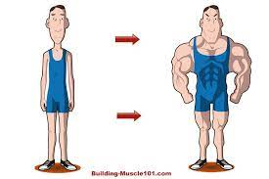
Try to have a calculative and moderate diet which contains proteins fats carbs and all necessary vitamins and minerals for your body
Do not rely to much on supplements and artificial food source have a moderate level of all this
Have a lot of water per day approx. 4 to 5 L
Divide your day and have short meals per day and don’t over eat on one meal and stay without food for a long time
Have more of fruits and vegetables
Cut sugar and refined cards
Train heavy

